Slide 1
Big Mountain Resort
Guided Capstone Project

Slide 2
Problem Identification
Big Mountain Resort wants to determine a better value for their ticket prices in order to increase revenue to cover the $1.54 million operating cost increase for this season. Determine the optimal ticket price by analyzing the data and finding the key factors to support a ticket price increase. Identify cost-cutting measures from the data that can support a ticket price increase for this season.

Slide 3
Context
The objective was to analyze data from 300 resorts that fit into the same market and identify key factors to support increasing the ticket price and cost-saving opportunities for the season.
To be successful, Big Mountain must see an increase in revenue, and maintain or increase customer satisfaction.
For this analysis market data was provided on 300 ski resorts throughout the US with amenities consistent with Big Mountain. This data was blended with data that contained population and state sizes sourced from Wikipedia.

Slide 4
Findings
Current ticket price does not take advantage of the resorts provided value.
Recommend a $10 increase in ticket price.
This price increase is supported by
Increasing the vertical drop of a run
Adding 1 chair lift
Increase snowmaking coverage by 2 acres
$18 million increase in revenue over the season.

Slide 5
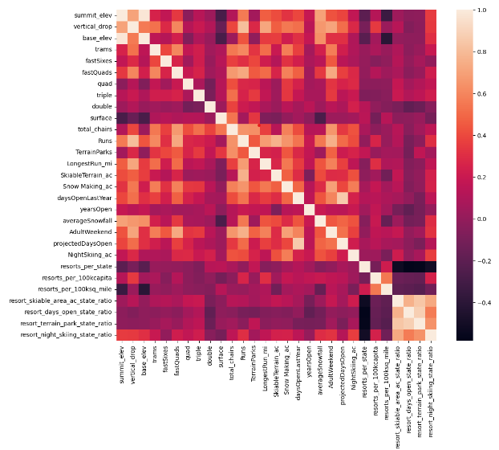
Modeling Data
Correlations were found from this heat map and used to train the machine learning model.
From this model we fed it our most correlated amenities to find the the most value.

Slide 6
Modeling Results
Scenario 1. Closing runs. Closing one run made no difference in the ticket price, but any more and ticket prices had to come down.
Scenario 2. Increase the vertical drop of 1 run and adding an additional chair lift. This scenario showed support for raising the ticket price by $9.13. With a seasonal revenue increase of $15,978,514.

Slide 7
Modeling Results
Scenario 3. Same as number 2, but adding 2 acres of snow making cover. This scenario showed support for a $10.42 increase per ticket. With a seasonal revenue increase of $18,235,761.
Scenario 4. Increase the longest run by 0.2 mile to boast 3.5 miles length, requiring an additional snow making coverage of 4 acres. This scenario supported a $0.0 ticket price increase.

Slide 8
Summary
These results look promising, data on operational costs is needed to add more depth to the model. This is a good starting point for Big Mountain to increase revenue.

